Slide 1
Bank Loan Analytics Presentation
Group – 6
Mentor – Mr.Pavan Kumar

Slide 2
Our Team
Tushar Agarwal
Manoj Kumar Mishra
Sachin Shankar Bargule
SHRINIVAS RAMAPPA BADAKAL
A.SAM
SHUBHAM KUMAR SHARMA

Slide 3
KPI’s
Year wise loan amount Stats
Grade and sub grade wise revol_bal
Total Payment for Verified Status Vs Total Payment for Non Verified Status
State wise and last_credit_pull_d wise loan status
Home ownership Vs last payment date stats

Slide 4
Contents
Excel Dashboard
Tableau Dashboard
Power Bi Dashboard
SQL Insights
Final KPIs with Insights

Slide 5
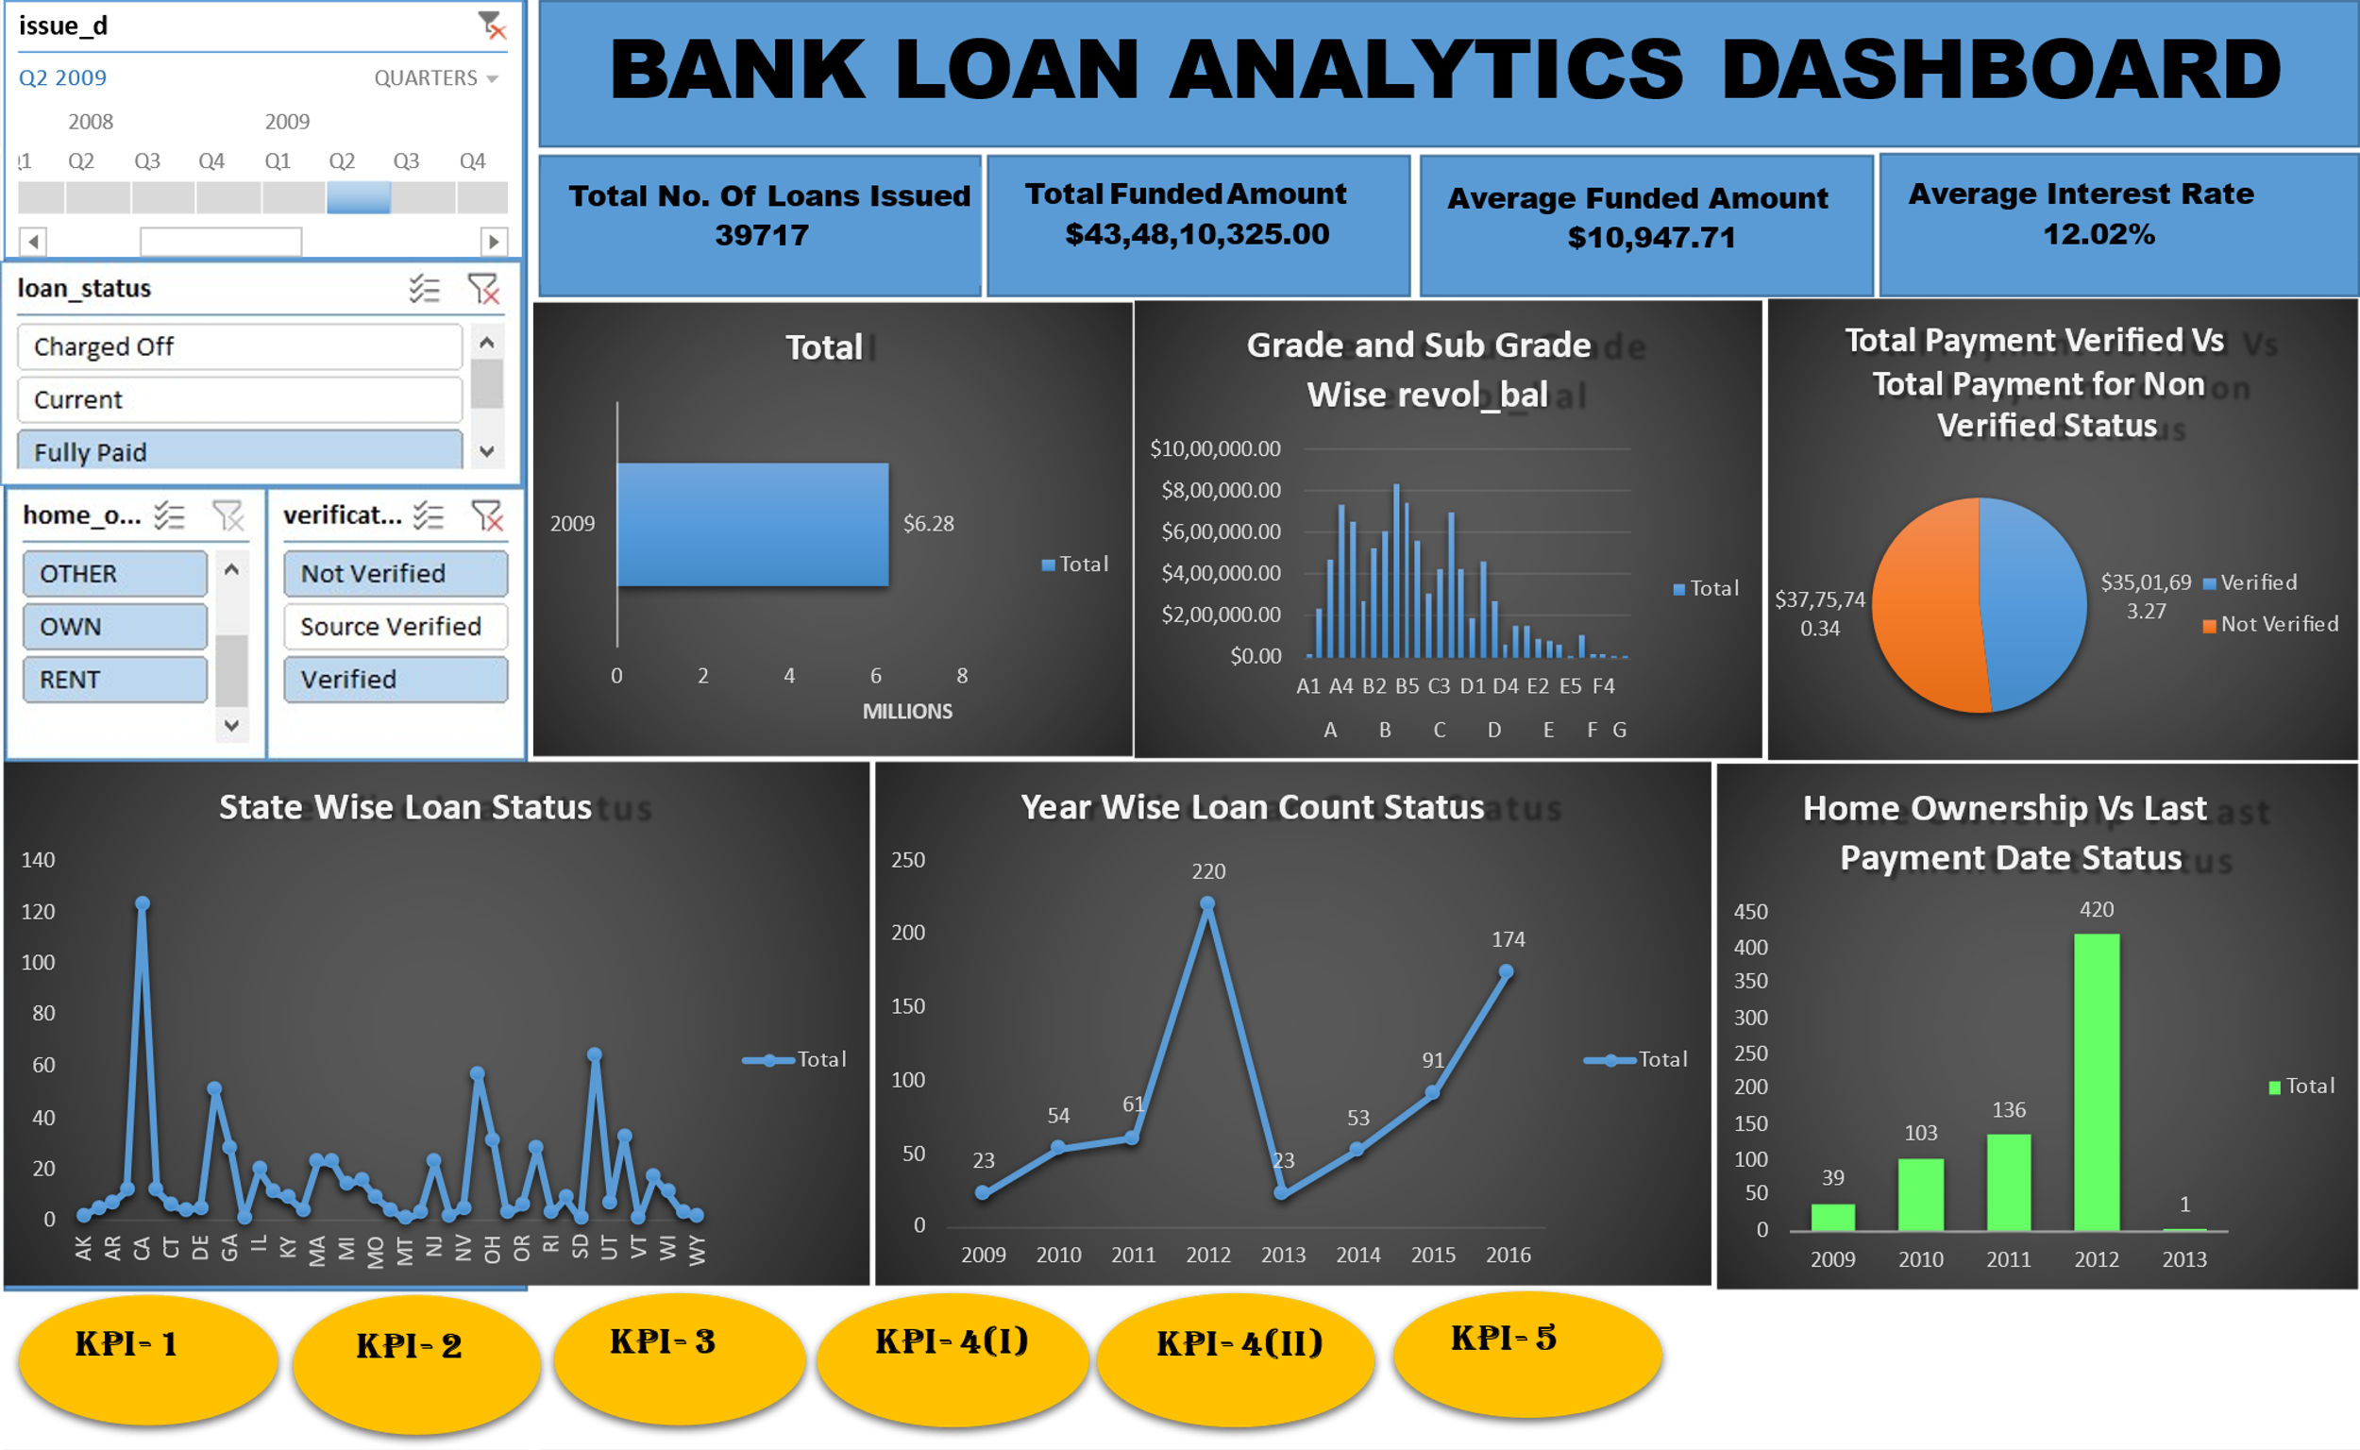
Excel Dashboard

Slide 6
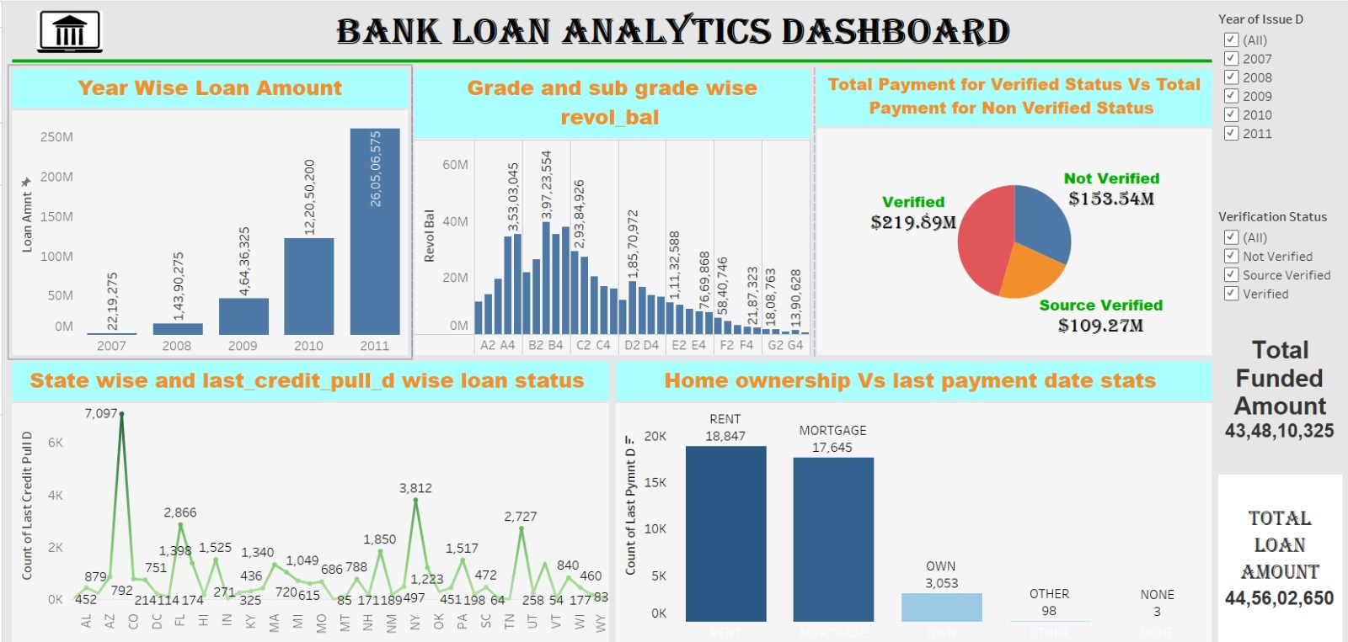
Tableau Dashboard

Slide 7
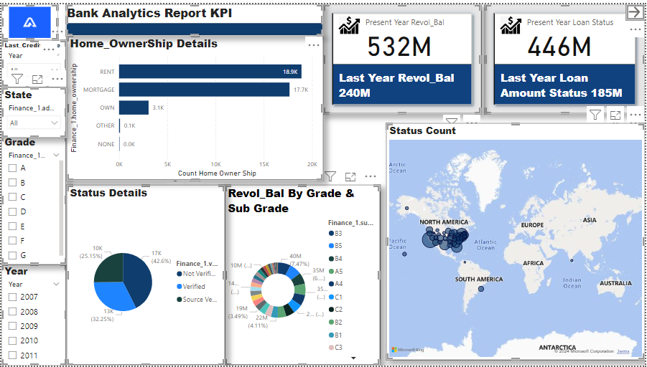
Power Bi Dashboard

Slide 8
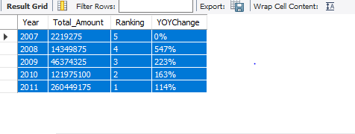
SQL KPI 1
# Year wise loan amount Stats

Slide 9
SQL KPI 2
# Grade and sub grade wise revol_bal
A | A1 | 11365196 | 5 | 0%
A | A2 | 14004780 | 4 | 23.23%
A | A3 | 19543922 | 3 | 39.55%
A | A4 | 34557156 | 2 | 76.82%
A | A5 | 35303045 | 1 | 2.16%
B | B1 | 21842079 | 5 | 0%
B | B2 | 26478439 | 4 | 21.23%
B | B3 | 39723554 | 1 | 50.02%
B | B4 | 35405811 | 3 | -10.87%
B | B5 | 37858666 | 2 | 6.93%
C | C1 | 29384926 | 1 | 0%
C | C2 | 27321114 | 2 | -7.02%
C | C3 | 20531370 | 3 | -24.85%
C | C4 | 16867691 | 4 | -17.84%
C | C5 | 16015609 | 5 | -5.05%
D | D1 | 12130255 | 5 | 0%
D | D2 | 18570972 | 1 | 53.1%
D | D3 | 16793781 | 2 | -9.57%
D | D4 | 13742947 | 3 | -18.17%
D | D5 | 13252474 | 4 | -3.57%
E | E1 | 11132588 | 1 | 0%
E | E2 | 10242033 | 2 | -8%
E | E3 | 9039059 | 3 | -11.75%
E | E4 | 7990991 | 4 | -11.59%
E | E5 | 7620630 | 5 | -4.63%
F | F1 | 5840746 | 1 | 0%
F | F2 | 4528248 | 2 | -22.47%
F | F3 | 3175435 | 3 | -29.87%
F | F4 | 2551064 | 4 | -19.66%
F | F5 | 2187323 | 5 | -14.26%
G | G1 | 1808763 | 1 | 0%
G | G2 | 1729627 | 2 | -4.38%
G | G3 | 832193 | 4 | -51.89%
G | G4 | 1390628 | 3 | 67.1%
G | G5 | 701515 | 5 | -49.55%

Slide 10

SQL KPI 3
# Total Payment for Verified Status Vs Total Payment for Non Verified Status

Slide 11
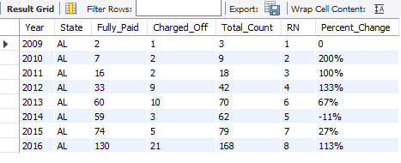
SQL KPI 4
# State wise and last_credit_pull_d wise loan status

Slide 12
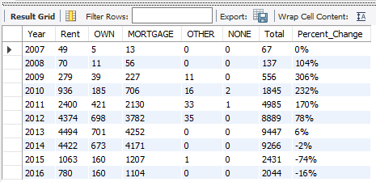
SQL KPI 5
# State wise and last_credit_pull_d wise loan status

Slide 13
Year wise loan amount Stats

Slide 14
Trend Analysis for Year wise loan amount Stats
2007 to 2008: The total value increased from 2,219,275 to 14,390,275. This is a significant rise, indicating more than a six-fold increase.
2008 to 2009: There was again a Increase in the total value from 14,390,275 to 46,436,325 . This suggests a increase of around 2.6 fold increase.
2009 to 2010: A dramatic increase occurred, with the total value jumping from 46,436,325 to 122,050,200. This is approximately a 2.6 fold increase.
2010 to 2011: The total value further increased to 260,506,575, more than doubling the previous year's value.

Slide 15
Grade and sub grade wise revol_bal

Slide 16
Analysis
Category A:
The values increase steadily from A1 to A5, with a peak at A5 (35,303,045).
Category B:
Similar to Category A, the values increase overall, peaking at B5 (37,858,666).
Category C:
The values are higher initially and then gradually decrease from C1 to C5, with C1 (29,384,926) being the highest.
Category D:
The values show some fluctuation, peaking at D2 (18,570,972).
Category E:
The values decrease steadily from E1 (11,132,588) to E5 (7,669,868).
Category F:
The values decrease steadily from F1 (5,840,746) to F5 (2,187,323).
Category G:
The values are generally lower, with G1 (1,808,763) being the highest and G5 (701,515) the lowest.
Total Sum:
The grand total of all the revolving balances across all categories and subcate

Slide 17
Total Payment for Verified Status Vs Total Payment for Non Verified Status

Slide 18
Analysis
Grand Total:
The grand total of all payments, both verified and not verified, is 373,433,725.7.
Observations:
Verified accounts have a substantially higher total payment amount compared to not verified accounts.
The data suggests that verified accounts contribute a larger portion of the total payments, indicating a potential correlation between account verification and payment activity.

Slide 19
State Wise Loan Status.

Slide 20
Insights
Summary:
High Activity: California, Florida, New York, and Texas show the highest activity in terms of loan counts across all statuses.
Low Activity: States like Wyoming, Vermont, and Maine have the lowest activity.
Risk Indicators: The number of Charged Off loans in states like California, Florida, and New York suggests areas with higher default rates.
Success Indicators: The high number of Fully Paid loans in these states also shows successful loan repayment.

Slide 21
last_credit_pull_d wise loan status
Summary:
Positive Indicators: The substantial increase in "Fully Paid" loans over time suggests improved loan repayment rates.
Potential Risks: The increase in "Charged Off" loans from 2014 indicates rising defaults, which could be a concern for lenders.
Active Loans: The gradual increase in "Current" loans shows a steady rise in ongoing loan activity.

Slide 22
Home ownership Vs last payment date stats

Slide 23
Insights
Dominance of "MORTGAGE" and "RENT":
"MORTGAGE" and "RENT" are the two dominant categories across all years. This indicates that most loan applicants either have a mortgage or are renting their homes.
Yearly Trends:
From 2010 to 2014, there is a significant increase in the number of loans for both "MORTGAGE" and "RENT" categories. This suggests an overall growth in loan issuance during these years.
The count of loans decreases after 2014, with a noticeable drop in 2015 and 2016.
"OWN" and "OTHER" Categories:
The "OWN" category shows a consistent but relatively smaller number of loans throughout the years.
The "OTHER" and "NONE" categories have minimal representation, indicating that very few loan applicants fall into these categories.
Pre-2008 Data:
There is a very low count of loans recorded before 2008, which could indicate less activity or data availability from those years.

Slide 24
Thank you

